Slide 1
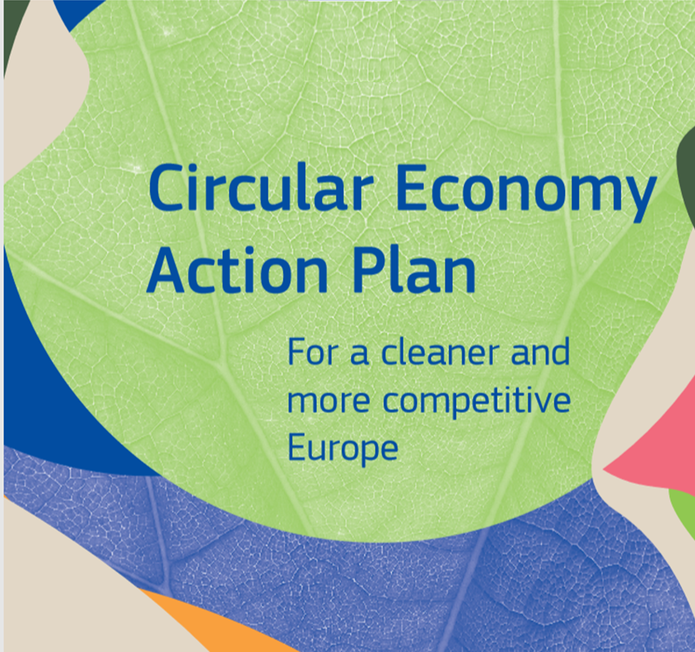
Sustainable Product Policy
Initiative
Hugo Maria Schally
DG Environment
European Commission

Slide 2
CLIMATE
PACT AND CLIMATE
LAW
PROMOTING
CLEAN
ENERGY
INVESTING IN MORE
SUSTAINABLE,
SMARTER MOBILITY
PROTECTING NATURE
STRIVING
FOR GREENER
INDUSTRY
The European
Green Deal
FROM FARM
TO FORK
ELIMINATING
POLLUTION
LEADING THE
GREEN CHANGE
GLOBALLY
ENSURING
A JUST TRANSITION
FOR ALL
MAKING
HOMES ENERGY EFFICIENT
FINANCING
GREEN
PROJECTS
Notes:
Building blocks of the European Green Deal

Slide 3
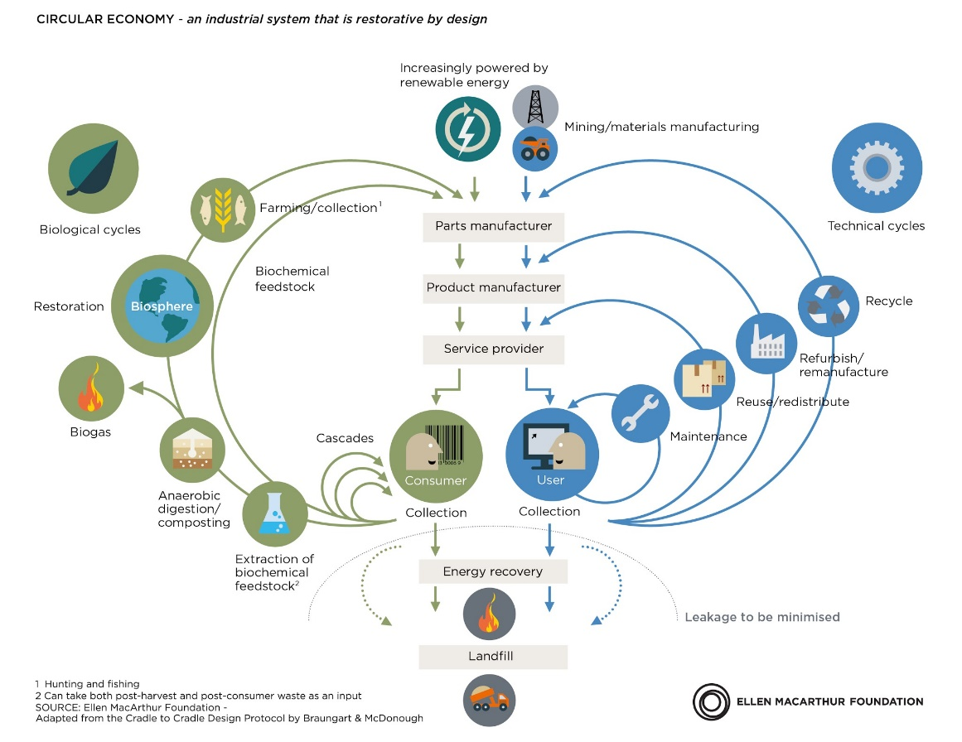

Slide 4
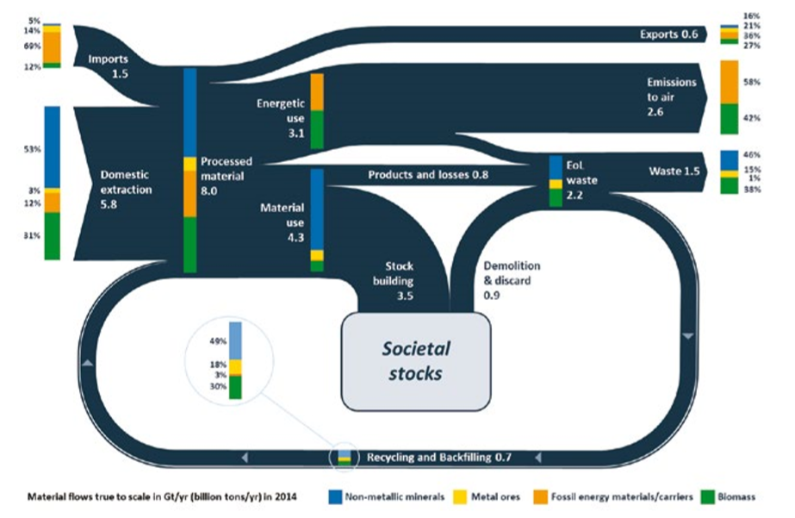

Slide 5
Crosscutting actions
Circular economy as prerequisite for climate neutrality
Measuring circularity contribution to climate mitigation
Strengthening the role of circularity in future revisions of the National Energy and Climate Plans
Certification of carbon removals
Getting the economics right
Integrating CE in EU Taxonomy Regulation
EU Ecolabel criteria for financial products
CE solutions in State Aid, business strategies, financial instruments and reporting
Research, innovation and digitalization
European Regional Development Fund/LIFE /HorizonEurope

Slide 6
A new vision for Products in the EU
Make sustainable products the norm in the EU
Empower consumers and public buyers
Sustainable production processes
Making circular economy work for people, regions and cities
Sustainable Product Policy Framework
Circular economy as a requisite for climate neutrality
Electronics and ICT
Batteries and vehicles
Packaging
Plastics
Textiles
Construction and buildings
Food, water and nutrients
Getting the Economics Right
Financial Markets
Key Value Chains
Less Waste More Value
Investments and R&I
Global Level Playing Field
Reduce Waste
Reduce Waste Exports
Boost market for high quality and safe secondary raw materials
Monitoring
35 actions

Slide 7
Towards a Sustainable Product Policy Framework
Our response
Many products break down too quickly, cannot be easily reused, repaired or recycled, and many are made for single use only.
Consumers do not repair products, find too many labels and some green claims are misleading.
Production processes in Europe are not resource efficient and can pollute our air, water and soil.
Product Design
Empowering consumers
Circularity in production processes
A new overarching framework addressing all products placed on the EU market, supporting more sustainable patterns of consumption and cutting waste by
e.g. promoting better design

Slide 8
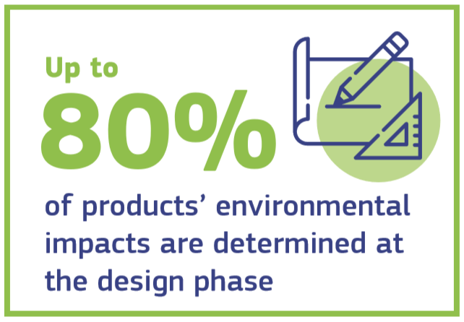
Designing sustainable products
Sustainable Product Policy Initiative “Green Products”
How?
Legislative proposal to set principles for product policy and requirements on products placed on the EU market
Adoption of the proposal planned for 2021
Widen the Ecodesign Directive beyond energy-related products
« Sustainable products should be the norm, not the exception »

Slide 9
Designing sustainable products
Sustainable Product Policy Legislative Initiative “Green Products”
What?
Improve durability, reusability, upgradability and reparability
Address presence of hazardous chemicals and increasing recycled content
Restrict single-use and counter premature obsolescence
Incentivise product-as-a-service
Digitalisation, including digital product passport
Implementation in key product value chains is priority

Slide 11
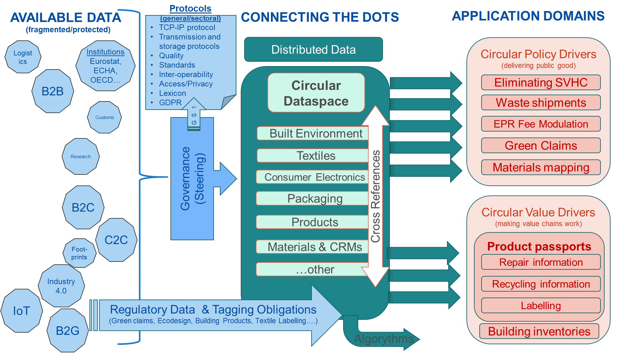

Slide 12
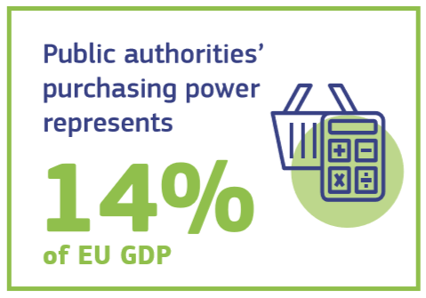
Empowering consumers and public buyers
Revision of the consumer law: consumers to receive trustworthy and relevant information on products at the point of sale
Establishing a new “Right to repair”
Legislative proposal to ensure companies substantiate their environmental claims using Product and Organisation Environmental Footprint methods
Include more systematically durability, recyclability and recycled content in EU Ecolabel criteria
c
Proposal for mandatory Green Public Procurement (GPP) criteria and targets in sectoral legislation
Phasing-in mandatory reporting on GPP

Slide 13
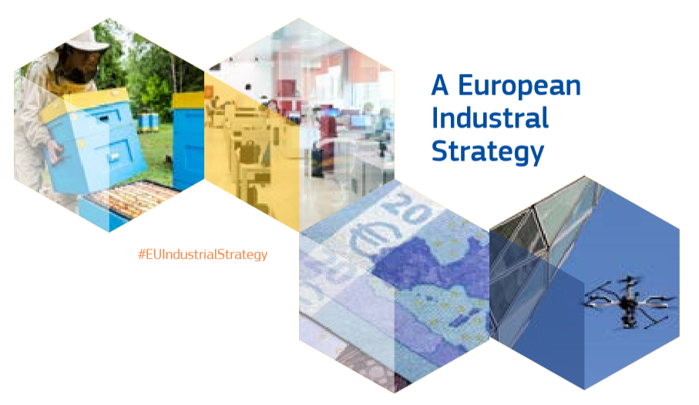
Circularity in production processes
Options for further promoting circularity in industrial processes in the context of the review of the Industrial Emissions Directive
Industrial symbiosis: reporting and certification system
EU Environmental Technology Verification scheme as a new EU certification mark
New SME Strategy (circular industrial collaboration among SMEs)
In synergy with:

Slide 14
Less waste, more value
- Preventing waste from being created in the first place is key
- Once waste has been created, it needs to be transformed into high-quality resources
Specific waste reduction targets for more complex streams
Enhance the implementation of the requirements for EPR schemes
Continue modernising EU waste laws (e.g. batteries, packaging, end-of-life vehicles, hazardous substances in electronic equipment )
Propose to harmonise separate waste collection systems
Review rules on waste shipments facilitating recycling or re-use within the EU; with also the aim to restrict exports of waste that cause negative environmental & health impacts
Assess the scope to develop further EU-wide end-of-waste criteria for certain waste streams

Slide 15
Toxic Free Environment
- Enhancing circularity in a toxic-free environment
Methodologies to track and minimise the presence of substances of concern in recycled materials and articles made thereof
The Chemicals Strategy for Sustainability further addresses the interface between chemicals, products and waste legislation

Slide 16
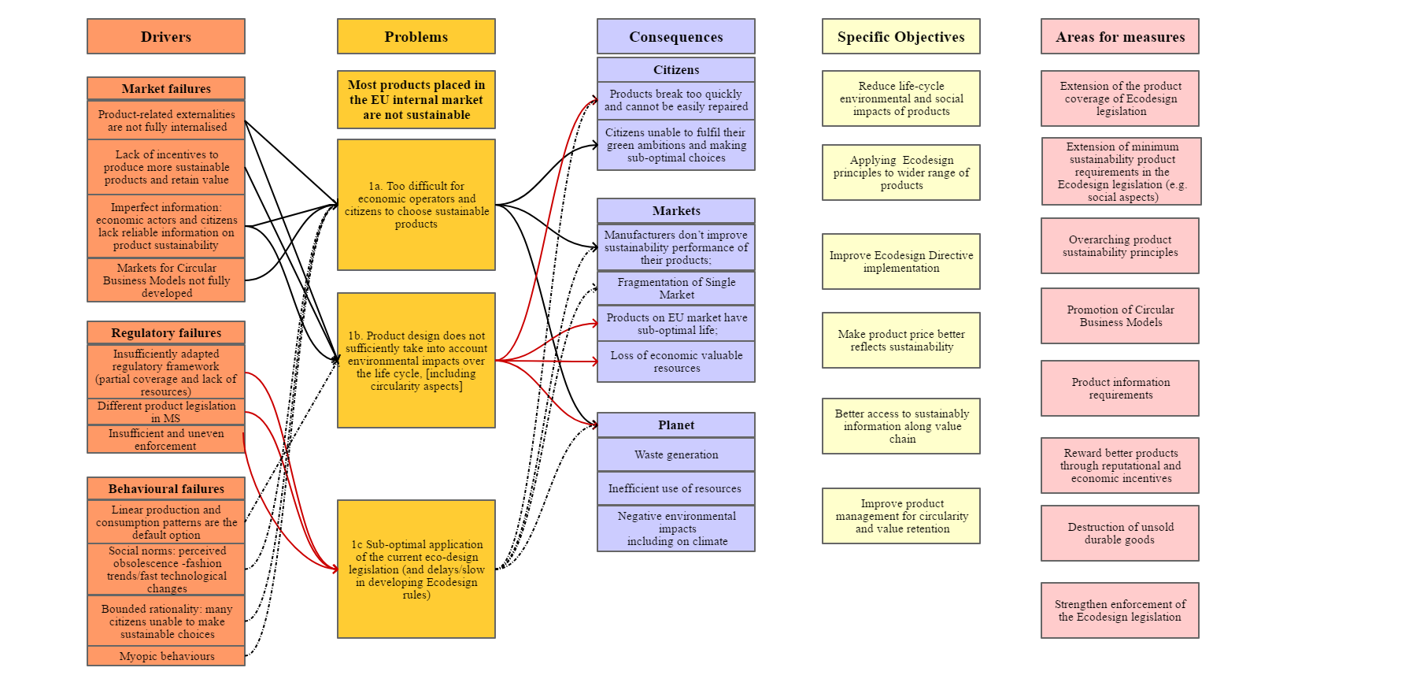

Slide 17
Thank you hugo-maria.schally@ec.europa.eu
© European Union 2021
Unless otherwise noted the reuse of this presentation is authorised under the CC BY 4.0 license. For any use or reproduction of elements that are not owned by the EU, permission may need to be sought directly from the respective right holders.

