Slide 1
Sustainability in EU public procurement law
.
May 6, 2021
This project has received funding from the European Union’s Horizon 2020 research and innovation
programme under the Marie Skłodowska-Curie grant agreement No 956696.

Slide 2
Internal Market
Vs
Sustainability
https://papers.ssrn.com/sol3/papers.cfm?abstract_id=3504676
This project has received funding from the European Union’s Horizon 2020 research and innovation
programme under the Marie Skłodowska-Curie grant agreement No 956696.

Slide 3
This project has received funding from the European Union’s Horizon 2020 research and innovation
programme under the Marie Skłodowska-Curie grant agreement No 956696.
Inter-institutional dynamics
European Parliament
Council/MS
Commission
Court of Justice

Slide 4
This project has received funding from the European Union’s Horizon 2020 research and innovation
programme under the Marie Skłodowska-Curie grant agreement No 956696.
2014/Directives
Horizon 2020
New rules, incl. ‘sustainability principle’,
labels,
award criteria and LCC
– generally not mandatory at EU level

Slide 5
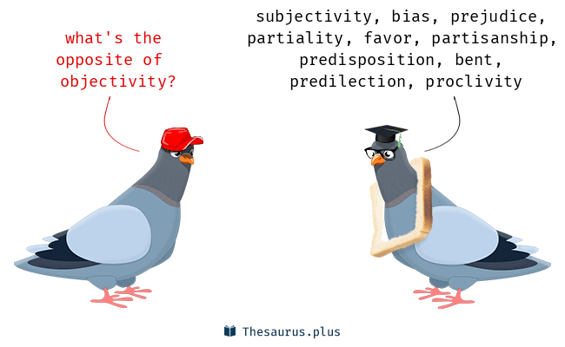
This project has received funding from the European Union’s Horizon 2020 research and innovation
programme under the Marie Skłodowska-Curie grant agreement No 956696.
A New Compromise Point

Slide 6
This project has received funding from the European Union’s Horizon 2020 research and innovation
programme under the Marie Skłodowska-Curie grant agreement No 956696.
LCC
Parts or all of the costs over the life cycle of a product, service or works costs, such as:
costs relating to acquisition
costs of use, such as consumption of energy and other resources
maintenance costs
end of life costs, such as collection and recycling costs
costs imputed to environmental externalities linked to the product, service or works during its life cycle, provided their monetary value can be determined and verified; such costs may include the cost of emissions of greenhouse gases and of other pollutant emissions and other climate change mitigation costs

Slide 7
This project has received funding from the European Union’s Horizon 2020 research and innovation
programme under the Marie Skłodowska-Curie grant agreement No 956696.
Methodology
based on objectively verifiable and non-discriminatory criteria. In particular, where it has not been established for repeated or continuous application, it shall not unduly favour or disadvantage certain economic operators
accessible to all interested parties
data required can be provided with reasonable effort by normally diligent economic operators, incl from third countries party to the GPA or other international agreements by which the Union is bound

Slide 8
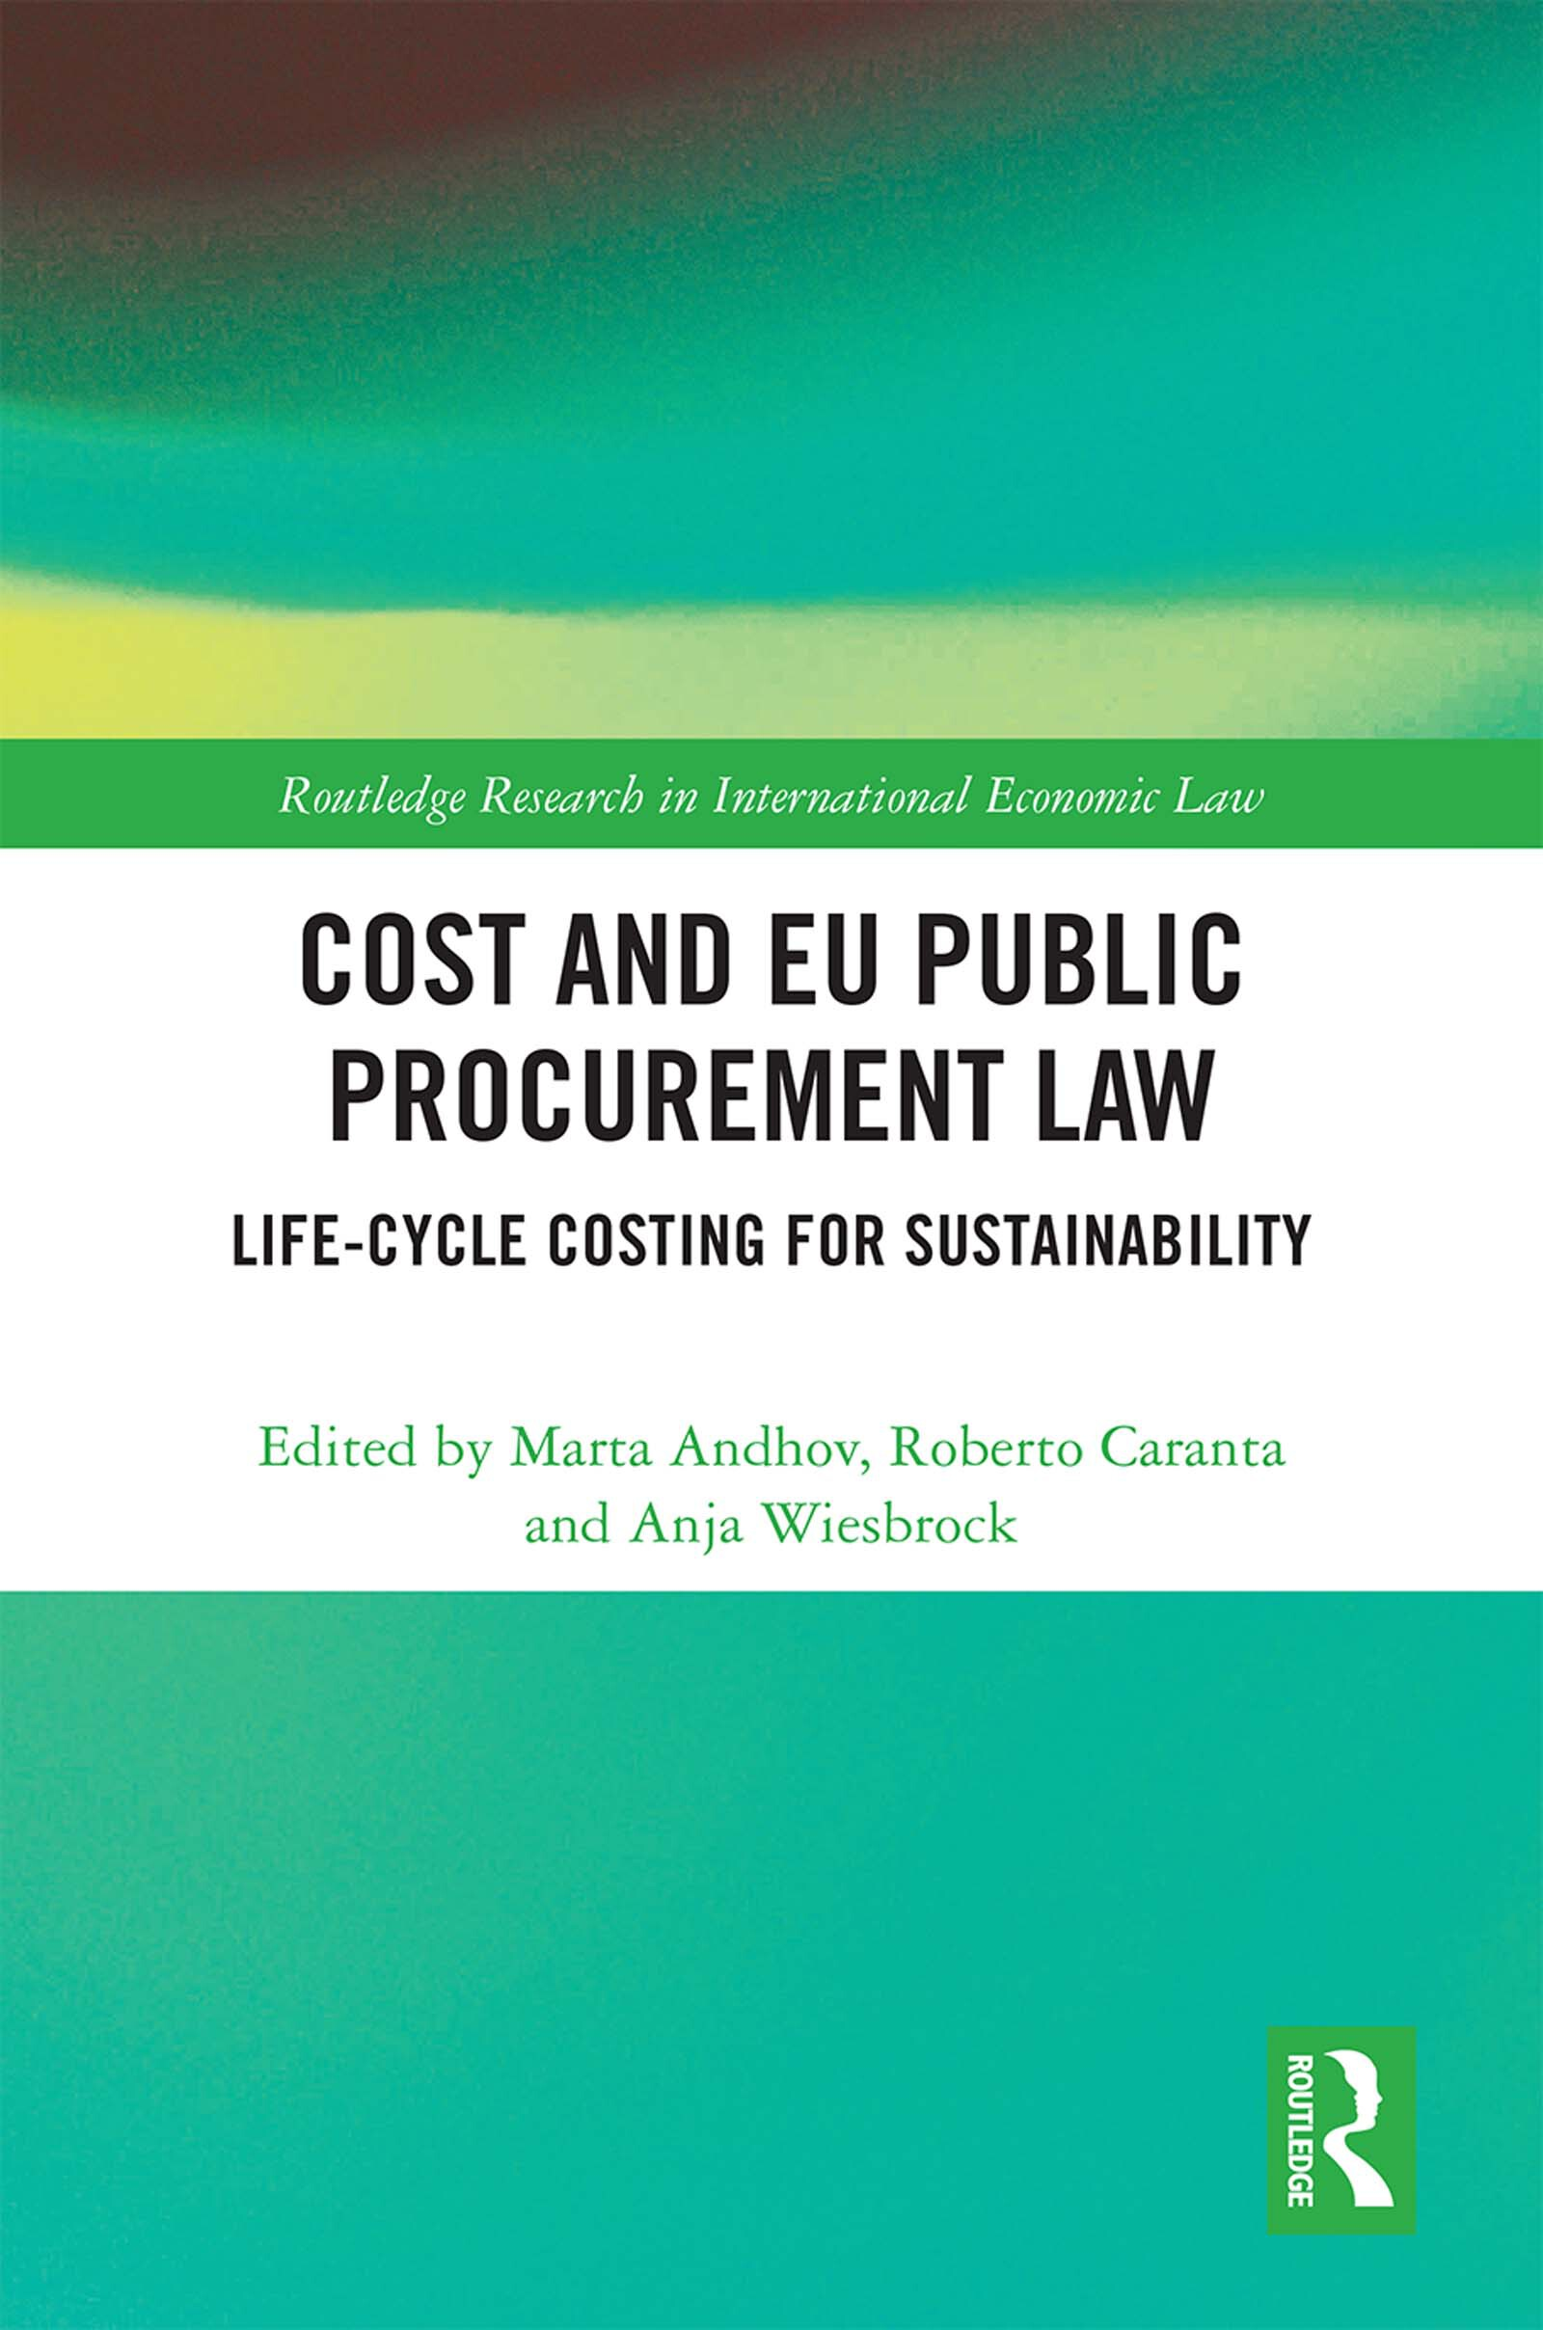
LCC calculation tools
The European Commission has developed a series of sector specific LCC calculation tools which aim to facilitate the use of LCC amongst public procurers.
https://ec.europa.eu/environment/gpp/lcc.htm
Incl one for Computers and monitors (to be updated to new GPP criteria
https://ec.europa.eu/environment/gpp/pdf/EC_LCC_computers_guide_final_updated_Mar2019.pdf

Slide 9
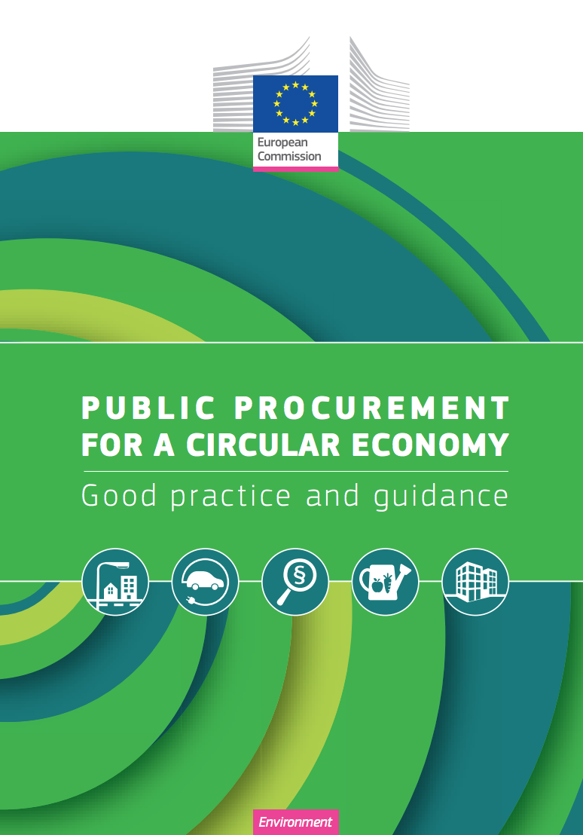
This project has received funding from the European Union’s Horizon 2020 research and innovation
programme under the Marie Skłodowska-Curie grant agreement No 956696.
Pivot towards the circular economy
within the current linear production and consumption economic model, only a small share of waste produced is reused, recycled or traded as secondary materials
given that resources are finite, economies will no longer be able to rely on these linear production and consumption models
circular economy aims to keep products and materials in the value chain for a longer period and to recover raw materials after the lifetime of products for their next use

Slide 10
This project has received funding from the European Union’s Horizon 2020 research and innovation
programme under the Marie Skłodowska-Curie grant agreement No 956696.
Some thoughts about monetization
Unethical concerning HRs, Workers’ rights (must be dealt w in selection)
May work with some social rights (eg employment of workers from disadvantaged categories), set asides or tie break usually preferred
Might raise ethical issues concerning some environmental aspects, offsets preferred
A trend concerning for instance climate/pollution
BUT amend. to Clean Vehicles Directive

Slide 11
LABELS
This project has received funding from the European Union’s Horizon 2020 research and innovation
programme under the Marie Skłodowska-Curie grant agreement No 956696.
Possibility to refer to specific labels BUT
Only if requirements linked to the subject matter (eg no CSR)
If not, indicate which label requirements are referred to
When a tenderer had demonstrably no possibility of obtaining the label within the relevant time limits for reasons that are not attributable to him/her, other appropriate means of proof shall be accepted

Slide 12
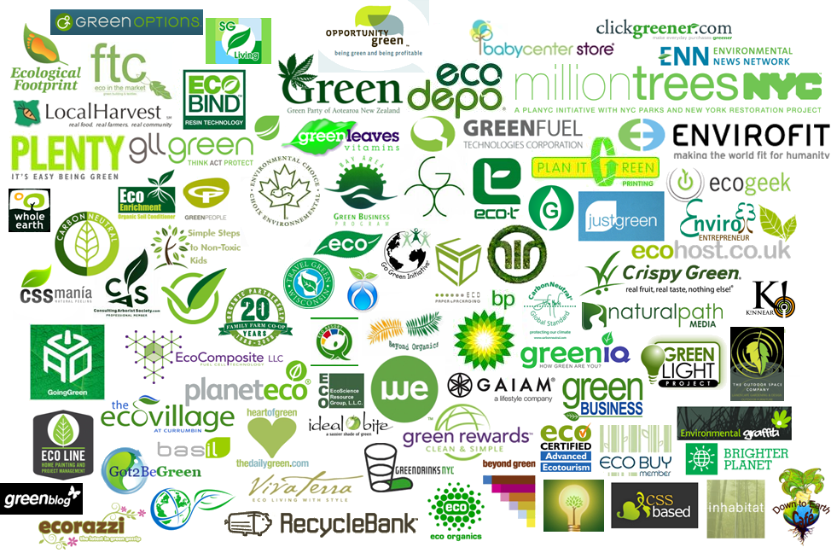
PROS/CAVEATS
Objective requirements verified by third parties (private labels can’t be considered)
May make the procurer’ life easier
Costs for EOs
Multitude of labels:

Slide 13
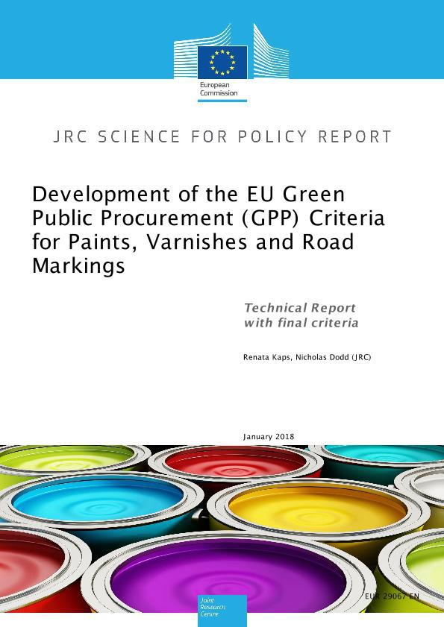
This project has received funding from the European Union’s Horizon 2020 research and innovation
programme under the Marie Skłodowska-Curie grant agreement No 956696.
GPP Criteria
Core criteria: designed to allow for easy application of GPP, focusing on the key area(s) of environmental performance of a product and aimed at keeping administrative costs for companies to a minimum.
Comprehensive criteria: take into account more aspects or higher levels of environmental performance, for use by authorities that want to go further in supporting environmental and innovation goals.
https://ec.europa.eu/environment/gpp/eu_gpp_criteria_en.htm

Slide 14
This project has received funding from the European Union’s Horizon 2020 research and innovation
programme under the Marie Skłodowska-Curie grant agreement No 956696.
The European Green Deal
Lot of emphasis on procurement
More Guidance
More mandatory criteria
https://privpapers.ssrn.com/sol3/papers.cfm?abstract_id=3589168#references-widget

Slide 15
This project has received funding from the European Union’s Horizon 2020 research and innovation
programme under the Marie Skłodowska-Curie grant agreement No 956696.
The Green Deal!
Public authorities, including the EU institutions, should lead by example and ensure that their procurement is green. The Commission will propose further legislation and guidance on green public purchasing.
COM(2019) 640 final

Slide 16
This project has received funding from the European Union’s Horizon 2020 research and innovation
programme under the Marie Skłodowska-Curie grant agreement No 956696.
A Renovation Wave for Europe –
greening our buildings, creating jobs, improving lives COM(2020) 662 final
by June 2022, the Commission will look into the possibility to develop green public procurement criteriafor public buildings such as office buildings and schools related to life-cycle and climate resilience and based on Level(s)
Commission’s Level(s) framework covers energy, material and water use, quality and value of buildings, health, comfort, resilience to climate change and life-cycle cost. https://ec.europa.eu/environment/eussd/buildings.htm

Slide 17
This project has received funding from the European Union’s Horizon 2020 research and innovation
programme under the Marie Skłodowska-Curie grant agreement No 956696.
Stepping up Europe’s 2030 climate ambition Investing in a climate-neutral future for the benefit of our people - COM(2020) 562 final
Continuous support for corporate sourcing of renewable energy, and establishing minimum mandatory green public procurement criteria and targets in relation to renewable energy may also be needed.

Slide 18
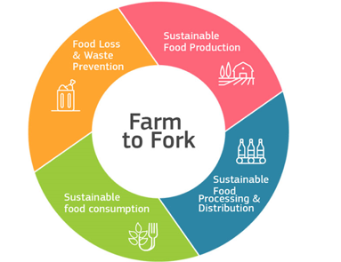
This project has received funding from the European Union’s Horizon 2020 research and innovation
programme under the Marie Skłodowska-Curie grant agreement No 956696.
Farm to Fork
To improve the availability and price of sustainable food and to promote healthy and sustainable diets in institutional catering, the Commission will determine the best way of setting minimum mandatory criteria for sustainable food procurement.
This will help cities, regions and public authorities to play their part by sourcing sustainable food for schools, hospitals and public institutions and it will also boost sustainable farming systems, such as organic farming.

Slide 19
This project has received funding from the European Union’s Horizon 2020 research and innovation
programme under the Marie Skłodowska-Curie grant agreement No 956696.
AN ACTION PLAN FOR THE DEVELOPMENT
OF ORGANIC PRODUCTION - COM(2021) 141 final
Action 3:
To stimulate a greater uptake of organics in public canteens, the Commission will, together with stakeholders and Member States:
boost the awareness of the criteria for GPP issued in 2019, of the work on Public Procurement of Food for Health, and of the Joint Action BestREMAP19;
integrate organic products into the minimum mandatory criteria for sustainable food public procurement to be developed as part of the legislative framework for sustainable food systems by 2023;

Slide 20
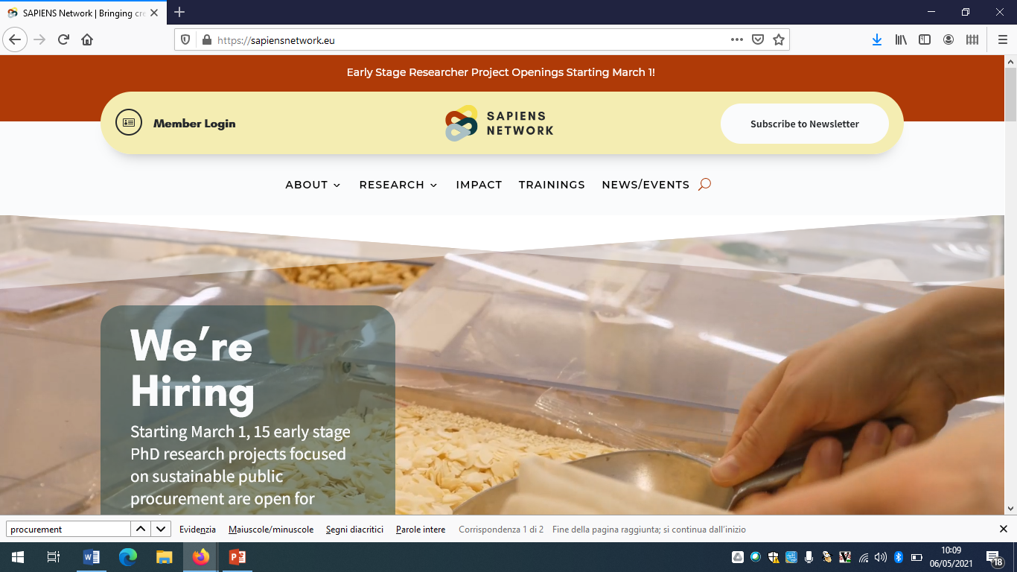
This project has received funding from the European Union’s Horizon 2020 research and innovation
programme under the Marie Skłodowska-Curie grant agreement No 956696.
THANKS!

